Slide 1




Time-Series Analysis
Retail sales data

Slide 2

Contents
Dataset
Objective
Data Infrastructure
Setting up environment
Exploratory Data Analysis
ARIMA/SARIMA statistical models
Prophet Time-Series Forecasting
Results
Conclusion & Next Steps

Slide 3

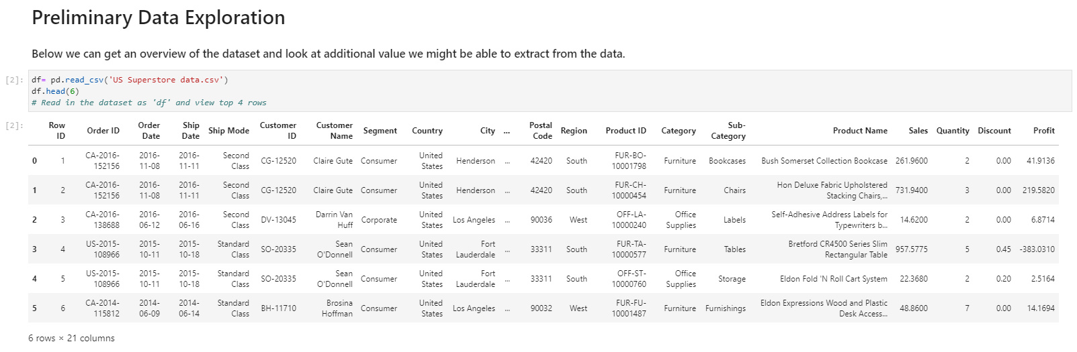
Data
Product Categories
Office Supplies | Furniture | Technology

Slide 4

Data Dictionary
'Row ID' - This is nothing but Serial No. 'Order ID' - ID created when a product order is placed. 'Order Date' - Date on which a customer places his/her order. 'Ship Date' - Date on which the order is shipped. 'Ship Mode' - Mode of shipment of each order. 'Customer ID' - ID assigned to each customer who places an order. 'Customer Name' - Name of Customer. 'Segment' - Section from where the order is placed. 'Country' - Country details of this data set. We are looking only for US store data. 'City' - Cities of US are listed here. 'State' - States of US are listed here. 'Postal Code' - pin code 'Region' - grouped into region wise 'Product ID' - Product ID of each product 'Category' - Category to which each product belongs to. 'Sub-Category' - Sub-Category of each Category 'Product Name' - Name of products. 'Sales' - Selling Price of each product. 'Quantity' - number of quantity available for a particular product. 'Discount' - Discount available on each product. 'Profit' - Profit gained on each product.
Data Source

Slide 5

Objective
“Time series forecasting is the use of a model to predict future values based on previously observed values.”
The objective of this project is to determine the ‘health’ of all 3 product categories in this dataset. We want to understand and capture trends & seasonality, but also predict profits for each category for the next couple years. While doing so, I will explore some of the best models and statistical methods to work with and make predictions with time-series data.

Slide 6
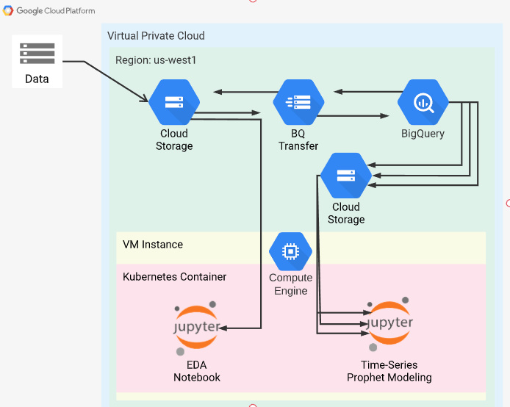



Data Infrastructure

Slide 7



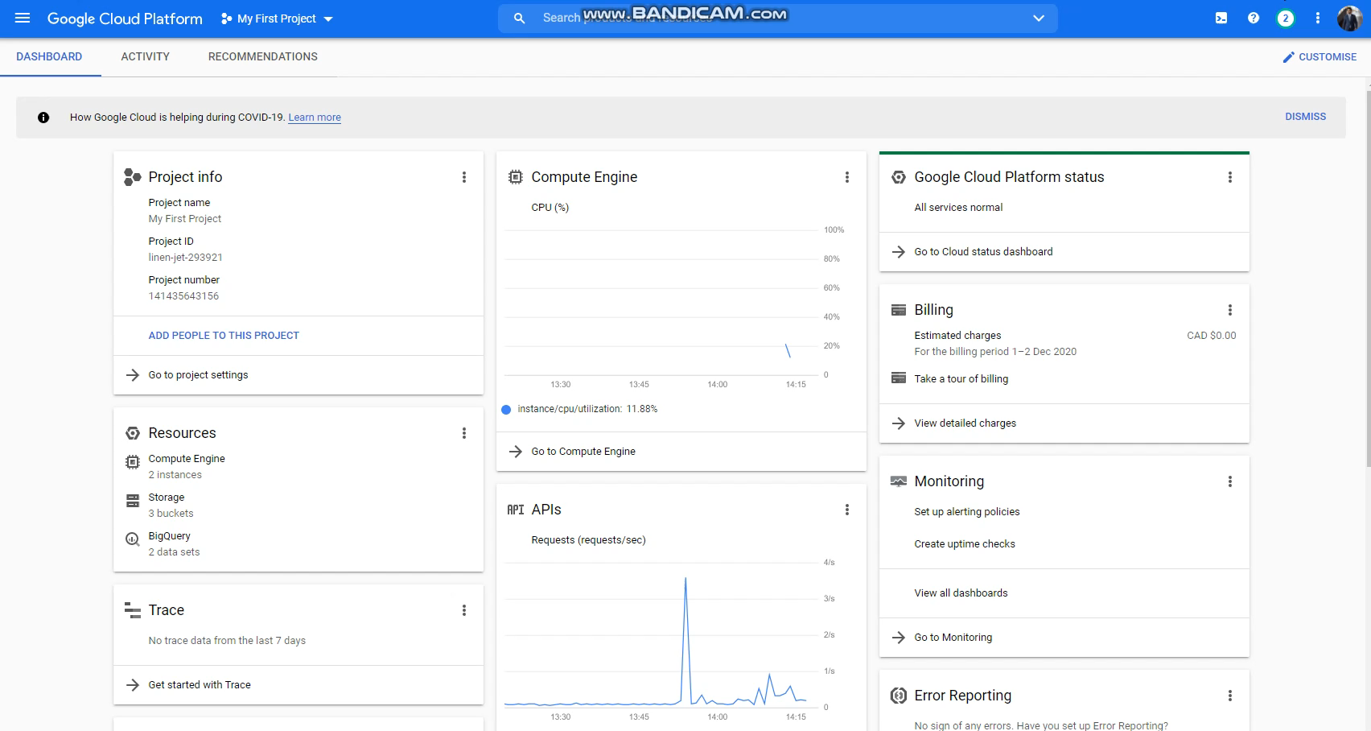
Setting up Environment

Slide 8

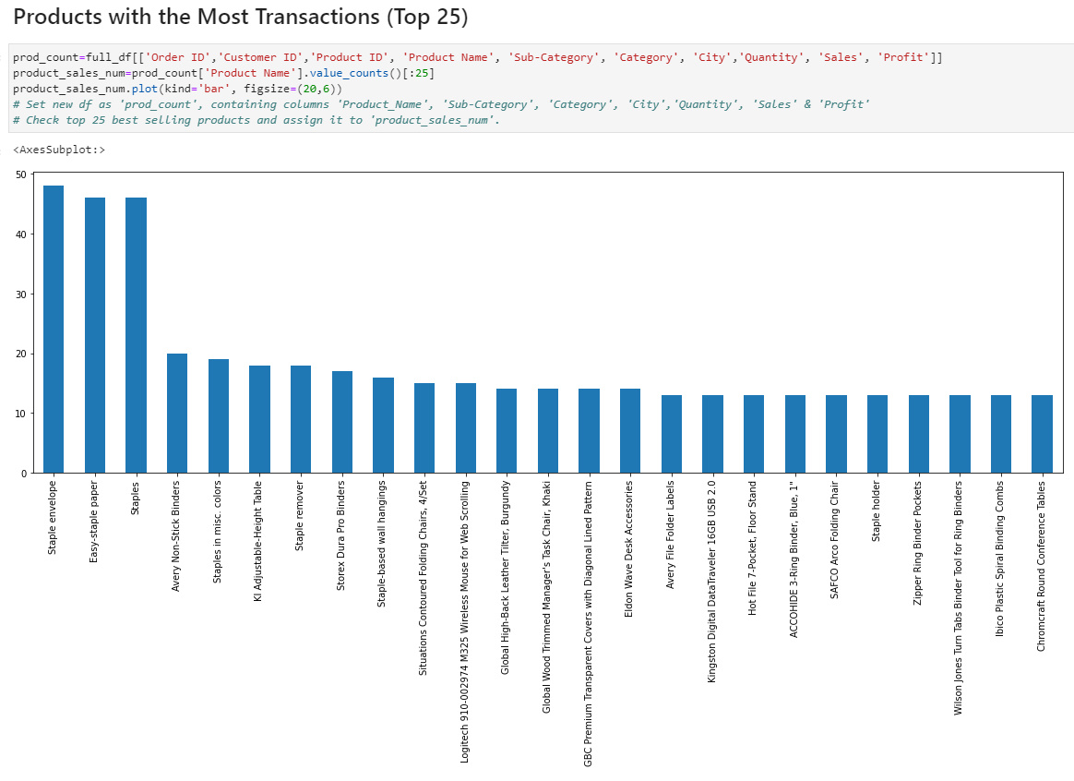
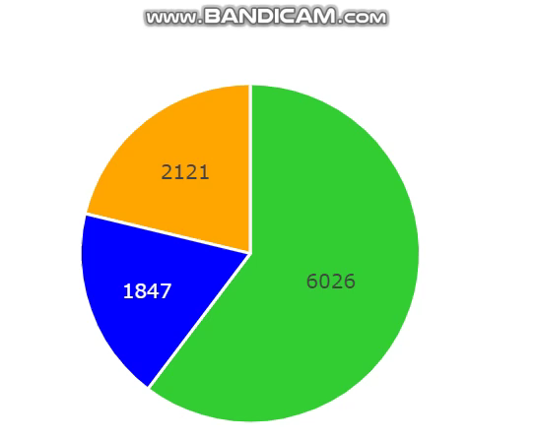
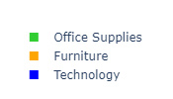
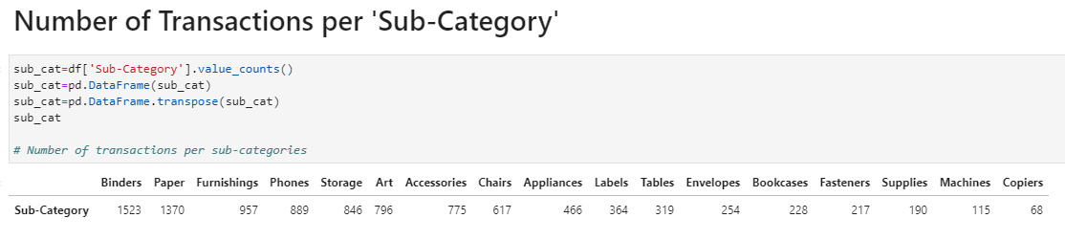
Exploratory Data Analysis
Transactions per Category

Slide 9
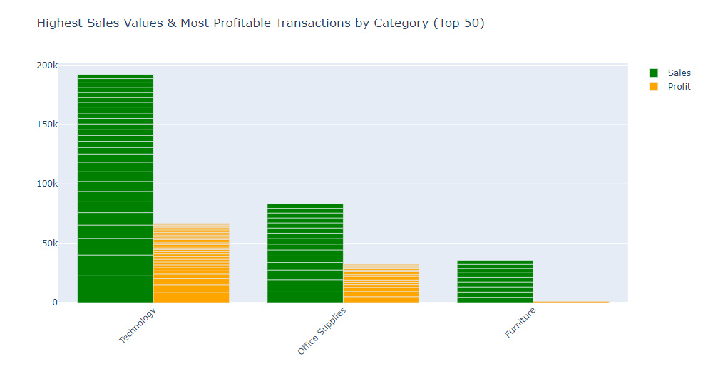
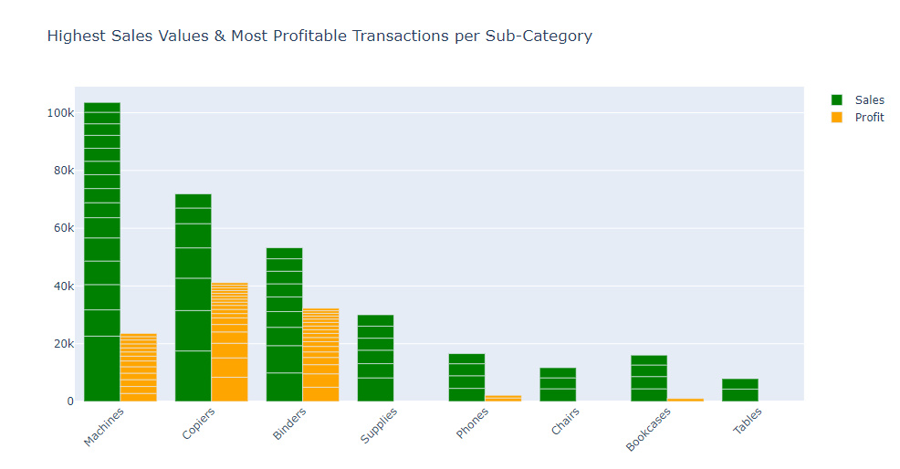
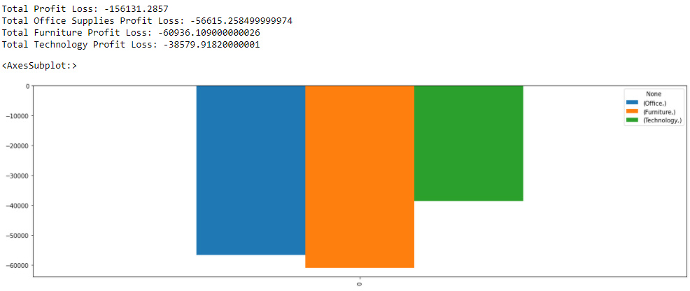

Exploring Profits

Slide 10
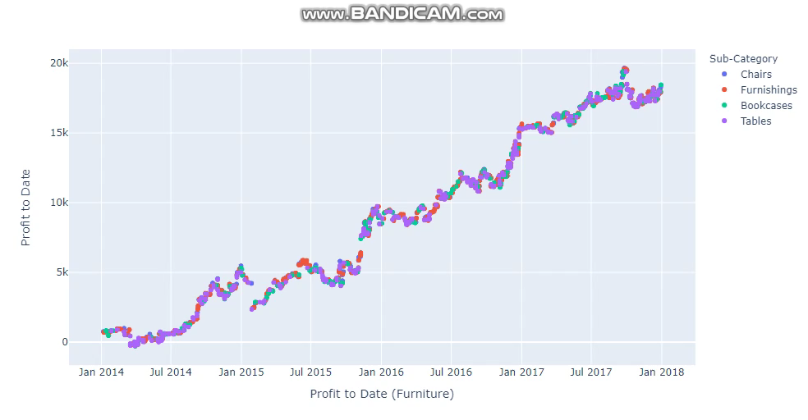


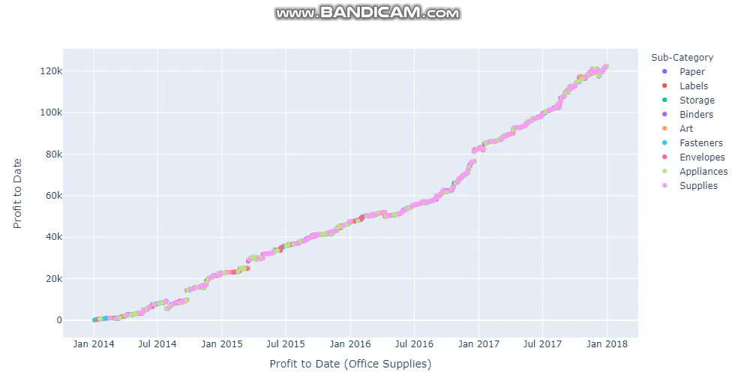
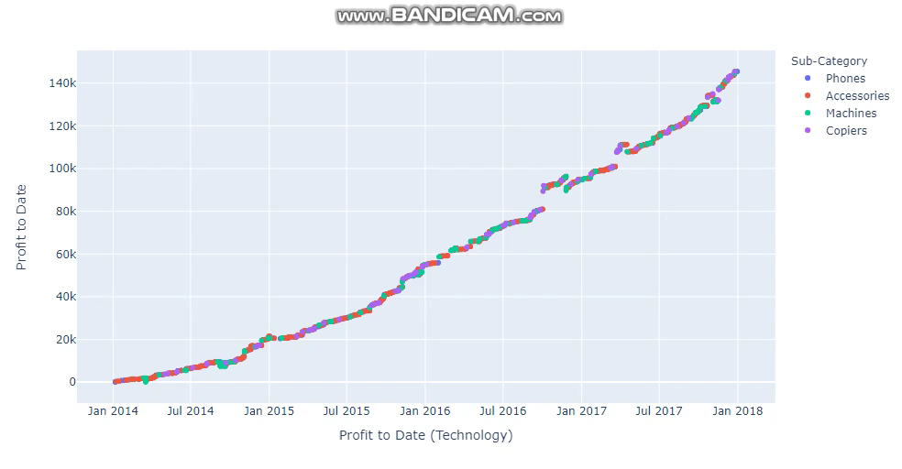
Plotting Profits Over Time

Slide 11
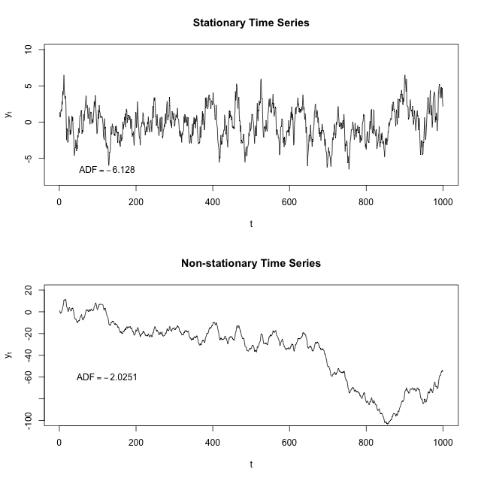

ARIMA/SARIMA Statistical Models
ARIMA: Autoregressive Integrated Moving Average
SARIMA: Seasonal Autoregressive Integrated Moving Average
Autoregressive Model: Representation of a random process over a linear time scale and the output is dependant on previous values.
Integrated: Represents that the data is not stationary.
Moving Average: Calculating data points by taking average of previous forecasting errors.
Seasonality: A trend in data over some time period, typically 1 year.
Resource

Slide 12

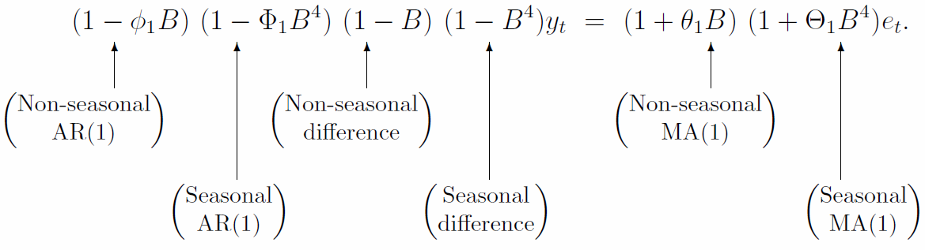
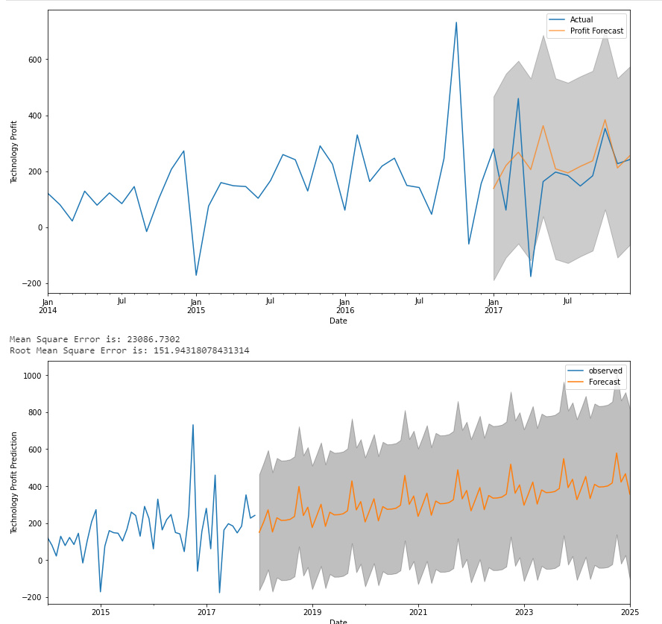
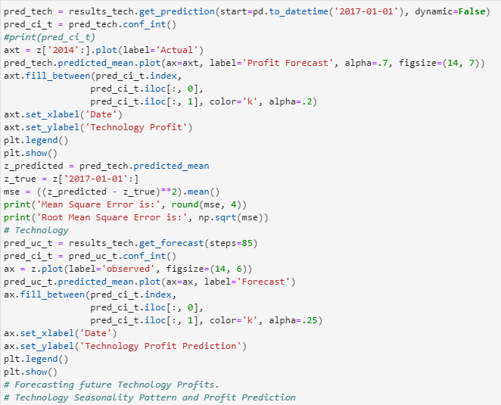
Implementing Models
SARIMA: (p,d,q) x (P,D,Q)s

Slide 13

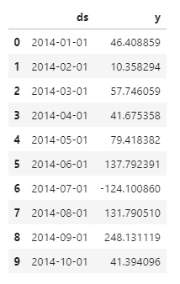
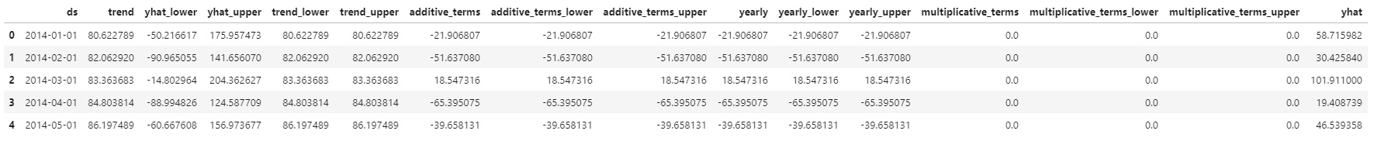
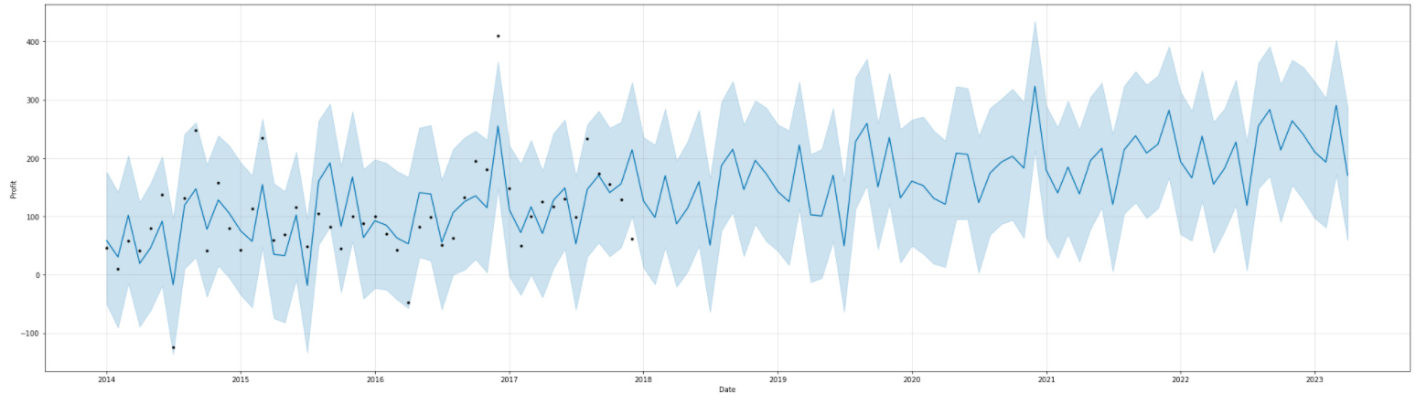

Predicting Profit with Prophet
Prophet was made open source by Facebook, for the purposes of time-series forecasting and the model looks at non-linear trends in seasonality. It focuses on 3 main components Trend, Seasonality and Holidays.
Data Input format:
Data Output:

Slide 14
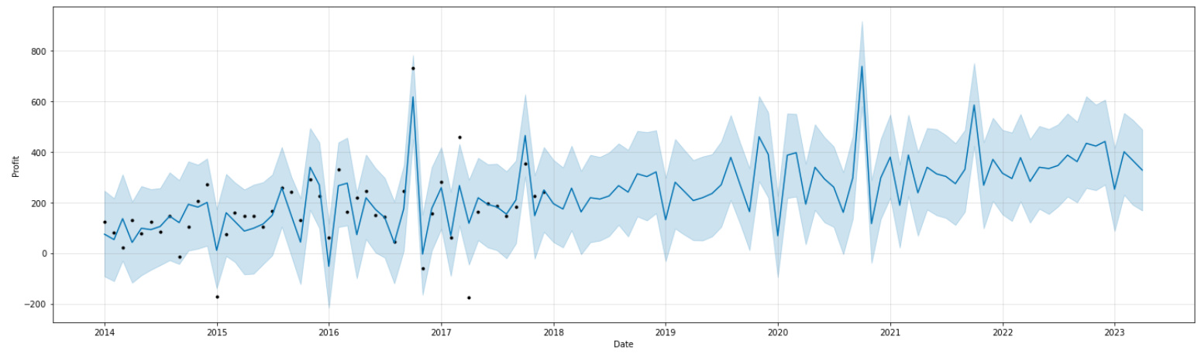
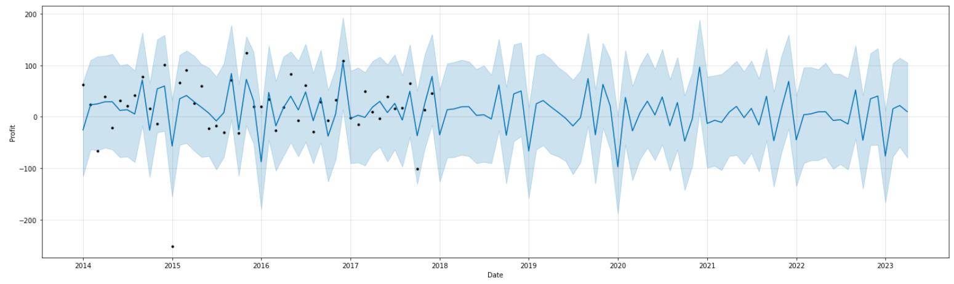
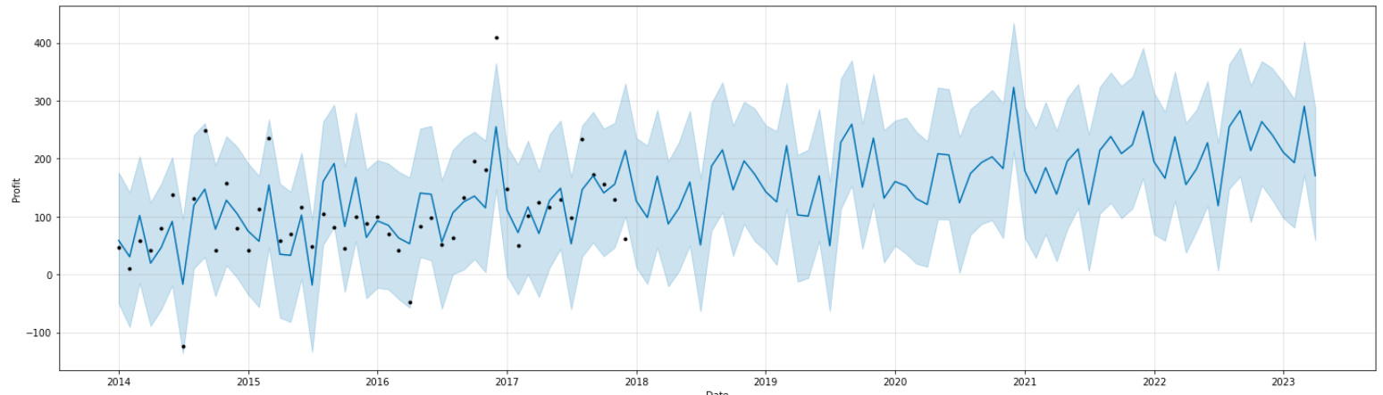
Technology
Forecast
Furniture Forecast
Office Supplies
Forecast

Slide 15
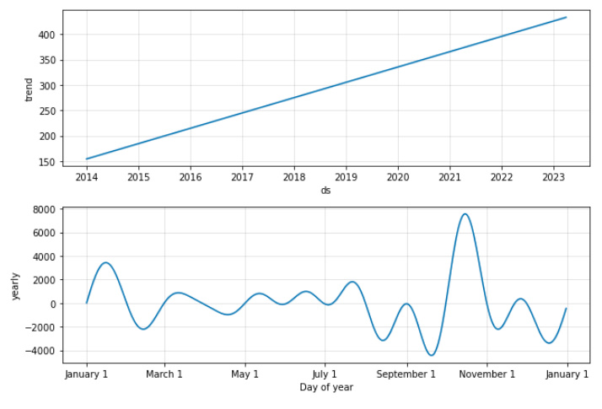
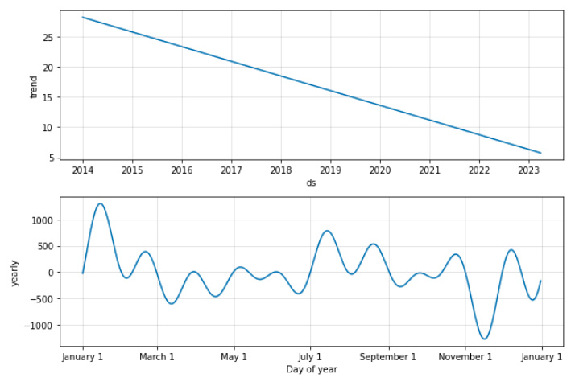
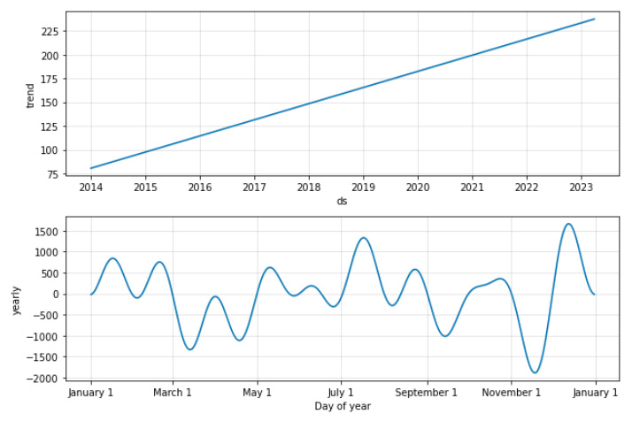


Trend & Seasonality
Technology
Trend & Seasonality
Furniture
Trend & Seasonality
Office Supplies
Trend & Seasonality

Slide 16
Comparing Models
 | Evaluation | Technology | Office Supplies | Furniture
ARIMA/SARIMA | MSE: | 23086.73 | 4911.82 | 3145.44
 | RMSE: | 151.94 | 70.08 | 56.08
Prophet | MSE: | 7209.14 | 3308.49 | 2108.26
 | RMSE: | 84.91 | 57.52 | 46.69

Slide 17
Conclusion & Next Steps
In conclusion we are able to get a pretty good understanding of the overall health of the 3 product categories and we are able to determine that technology and office supplies are trending upward and profits are expected to grow year over year. However when it comes to the furniture category, we can see that it is not trending upward in regards to profits. It was fairly clear from the ARIMA/SARIMA models but made even more apparent utilizing the Prophet model.
Next Steps:
Automate GCP Pipeline
Investigate Furniture category reasons for poor performance
Prophet modeling for sub-categories

